Slide 1
CIFAR - 10 IMAGE CLASSIFICATION
Convolutional Neural Networks

Slide 2
The CIFAR 10 DATASET
The CIFAR-10 dataset (Canadian Institute For Advanced Research) is a collection of images that are commonly used to train machine learning and computer vision algorithms. It is one of the most widely used datasets for machine learning research.The CIFAR-10 dataset contains 60,000 32x32 color images in 10 different classes.The 10 different classes represent airplanes, cars, birds, cats, deer, dogs, frogs, horses, ships, and trucks. There are 6,000 images of each class.

Slide 3
What is Convolution ?
A convolution is a linear operation that involves the multiplication of a set of weights with the input, much like a traditional neural network.
The multiplication is performed between an array of input data and a two-dimensional array of weights, called a filter or a kernel.

Slide 4
What are CNN ?
A convolutional neural network (CNN) is a type of artificial neural network used in image recognition and processing that is specifically designed to process pixel data.
CNNs are powerful image processing, artificial intelligence (AI) that use deep learning to perform both generative and descriptive tasks, often using machine vision that includes image and video recognition, along with recommender systems and natural language processing

Slide 5
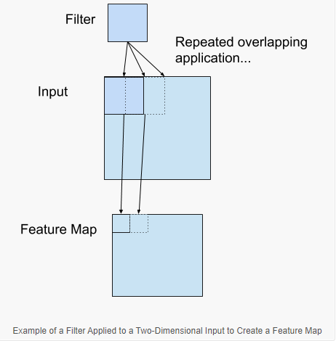
FEATURE MAPPING
The feature map is the output of one filter applied to the previous layer. A given filter is drawn across the entire previous layer, moved one pixel at a time. Each position results in an activation of the neuron and the output is collected in the feature map.

Slide 6
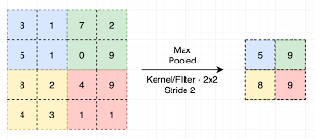
MAX POOLING
Convolutional networks may
include local or global pooling
layers to streamline the
underlying computation.
Pooling layers reduce the
dimensions of the data by
combining the outputs of neuron clusters at one layer into a single neuron in the next layer. Local pooling combines small
clusters, typically 2 x 2. Output
is the maximum of the elements
in 2 x 2 matrix

Slide 7
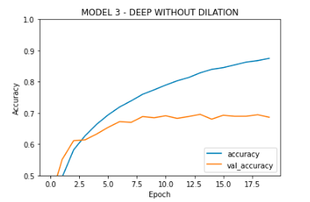
MODEL TRAINED WITH DEEP LAYERS - OVERFIT
Increasing the number of layers in a CNN will
make the model overfit . As a result the training
accuracy will be higher while the model will
not generalise and the testing accuracy will be
Lower as we can see from the image

Slide 8
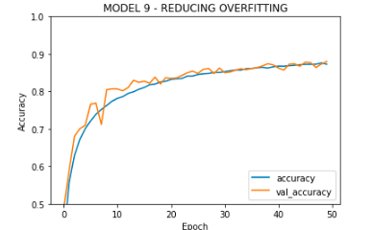
HANDLE OVERFITTING
We can incorporate Batch Normalisation
Dropouts and Data Augmentation methods
so that the model generalises well and
the test accuracy is increased
Here by using these techniques an accuracy
of 87 % has been achieved

Slide 9
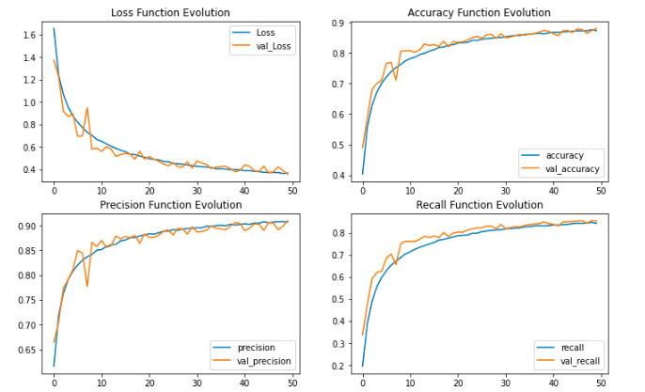
MODEL METRICS

Slide 10
SUMMARY
The CNN models are the basis of any kind of Image classification problems .
The model can be trained with the pre-trained weights from Transfer Learning Techniques and results can be compared .

